Slide 1
Contraceptives uptake in Fiji 1974 data analysis

Slide 2
Background & Rationale
Early 1960s - background
Fijian Government implemented a family planning policy.
Family planning available in government health facilities
Free contraceptives provided by the Government
Nowadays (1974) - rationale
Medical Department and Bureau of Statistics want to use data from World Fertility survey from Fiji to:
Observe the effectiveness of the policy on the use of contraceptives
Analyse a possible cause of differences in use of contraceptives

Slide 3
Research Questions
Population of interest:
Fecund women that have been married in Fiji between 15 and 49 years old
1. Do difference in contraceptive uptake vary by region in fecund women?
H0: There is no difference in contraceptive uptake by region
H1: There is a difference in contraceptive uptake by region
2. Are differences in contraceptive uptake in different regions explained by differences in ethnicity in fecund women?
H0: The odds ratios of not using contraceptives between different regions is equal to 1
H1: The odds ratio of not using contraceptives between regions is not equal to 1
Notes:
In particular, we decided to analyse if contraceptive uptake varied by region? And if so if this was influenced by differences in ethnicity. In order to answer these questions we formulated the following hypothesis...

Slide 4
Methods
Dataset used
World Fertility Survey from Fiji in 1974
Exclusion criteria
Infecund
Currently pregnant
Not exposed (to current contraceptive)
Self-spouse sterilized
Variables
Variables
Outcome: Current use of efficient contraceptive (converted to binary variable)
Outcome: Current use of efficient contraceptive (converted to binary variable)
Research question 1
Research question 2
Exposure: Region
Exposure: Region
Covariates
Statistical analysis
Age
Ethnicity
Chi-squared test
Statistical analysis
Logistic regression
Sensitivity analysis
Education
Occupation
Notes:
. Do difference in contraceptive uptake vary by region in fecund women
Exlucsti in order to focus on target population
Age can influence many influnce
Ehiniciy the varriable we interest in
Sensitiity analysis Education
We combine the not using / using ineffiecent together comparing using efficient
Are differences in contraceptive uptake in different regions explained by differences in ethnicity in fecund women?

Slide 5
Characteristics of study population
 | Overall N=2886 | %
Mean Age (SD) | 29.76 (7.48)
Ethnicity Fijian Indian European Part-European Pacific islander Chinese Other | 1206 1557 13 38 47 11 2 | 41.8% 53.9% 0.5% 1.3% 1.6% 0.38% 0.7%
 | Overall N=2886 | %
Region Central Western Northern Eastern | 1024 1173 582 107 | 35.5% 40.6% 20.2% 3.71%
Education None Lower primary Upper primary Secondary/higher | 456 1029 966 435 | 15.8% 35.7% 33.5% 15.1%
Notes:
The mean age of study population is 30 years

Slide 6
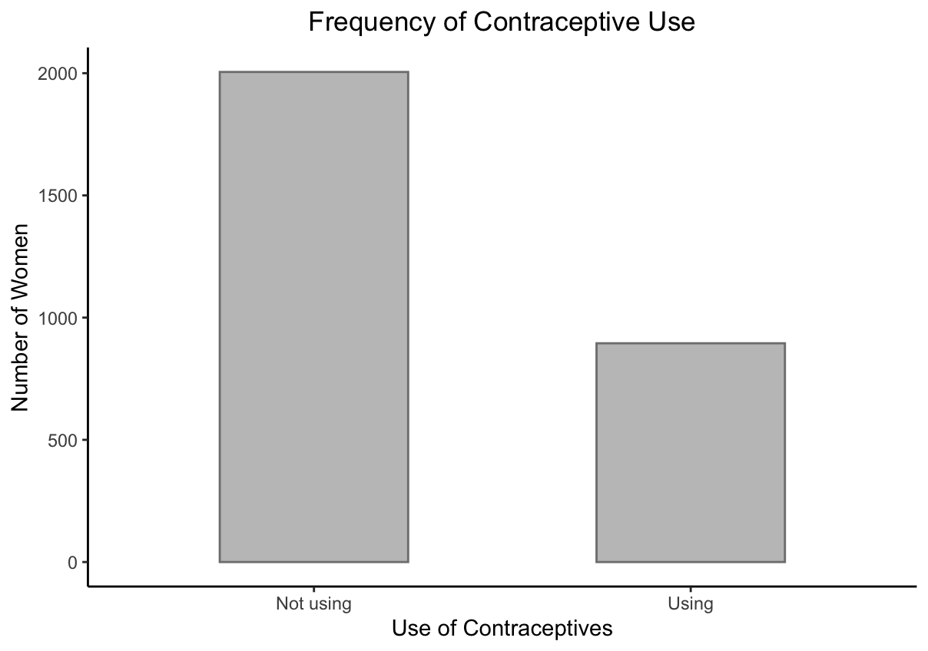
Overall use of contraceptives in the study population

Slide 7
1. Differences in contraceptive uptake in each region
Observed
Expected
 |  | Efficient use |  | Total
 |  | Yes | No
Region | Western | 413 | 760 | 1173
 | Central | 312 | 712 | 1024
 | Northern | 133 | 449 | 582
 | Eastern | 35 | 72 | 107
Total |  | 893 | 1993 | 2886
 |  | Efficient use |  | Total
 |  | Yes | No
Region | Western | 363.0 | 810.0 | 1173
 | Central | 316.9 | 707.1 | 1024
 | Northern | 180.1 | 401.9 | 582
 | Eastern | 33.1 | 73.9 | 107
Total |  | 893 | 1993 | 2886
χ² (3, N = 2886) = 28.1, p < 0.001 *
* Assumption: counts are independent
Notes:
From the odds ratio we see that that the northern region has the most risk of unwanted pregnancy due to least efficiency of contraceptive uptake.

Slide 8
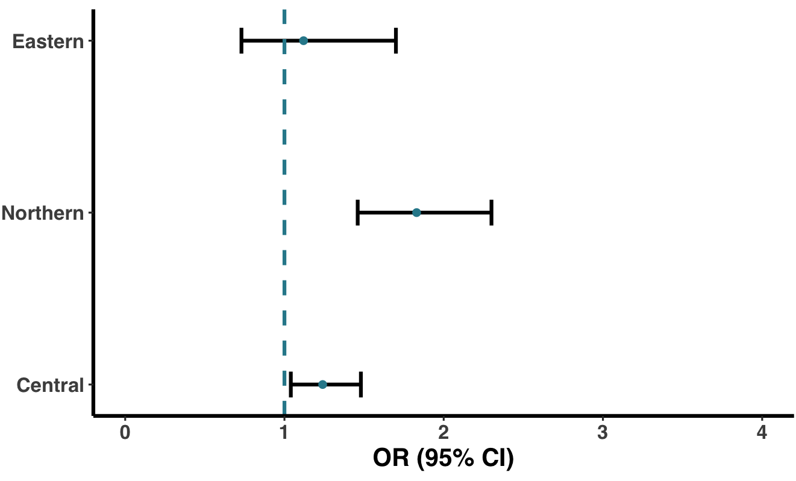
2. Logistic regression of contraceptive uptake by region
1.12 (0.73-1.70)
1.83 (1.46-2.30) **
1.24 (1.04-1.48) *
* p-value < 0.05, ** p-value < 0.01; reference: Western.

Slide 9
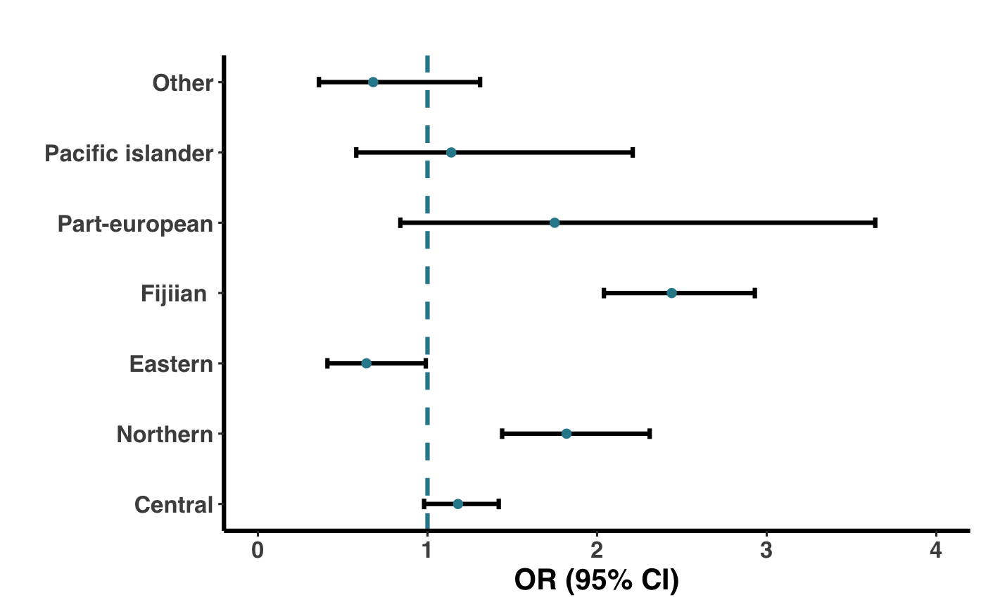
2. Logistic regression of contraceptive uptake adjusted for ethnicity
0.68 (0.36-1.31)
1.14 (0.58-2.21)
1.75 (0.84-3.64)
2.44 (2.04-2.93) **
0.64 (0.41-0.99) *
1.82 (1.44-2.31) **
1.13 (0.98-1.42)
* p-value < 0.05, ** p-value < 0.01; reference: Western (region), Indian (ethnicity).

Slide 10
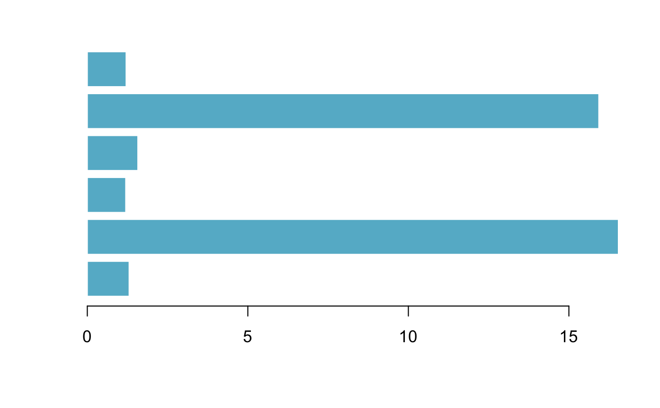
Variance Inflation Factors to test collinearity
Region
Ethnicity
Age
Education
Religion
Occupation
Notes:
region", "eth", "age", "education", "religion", "occu"

Slide 11
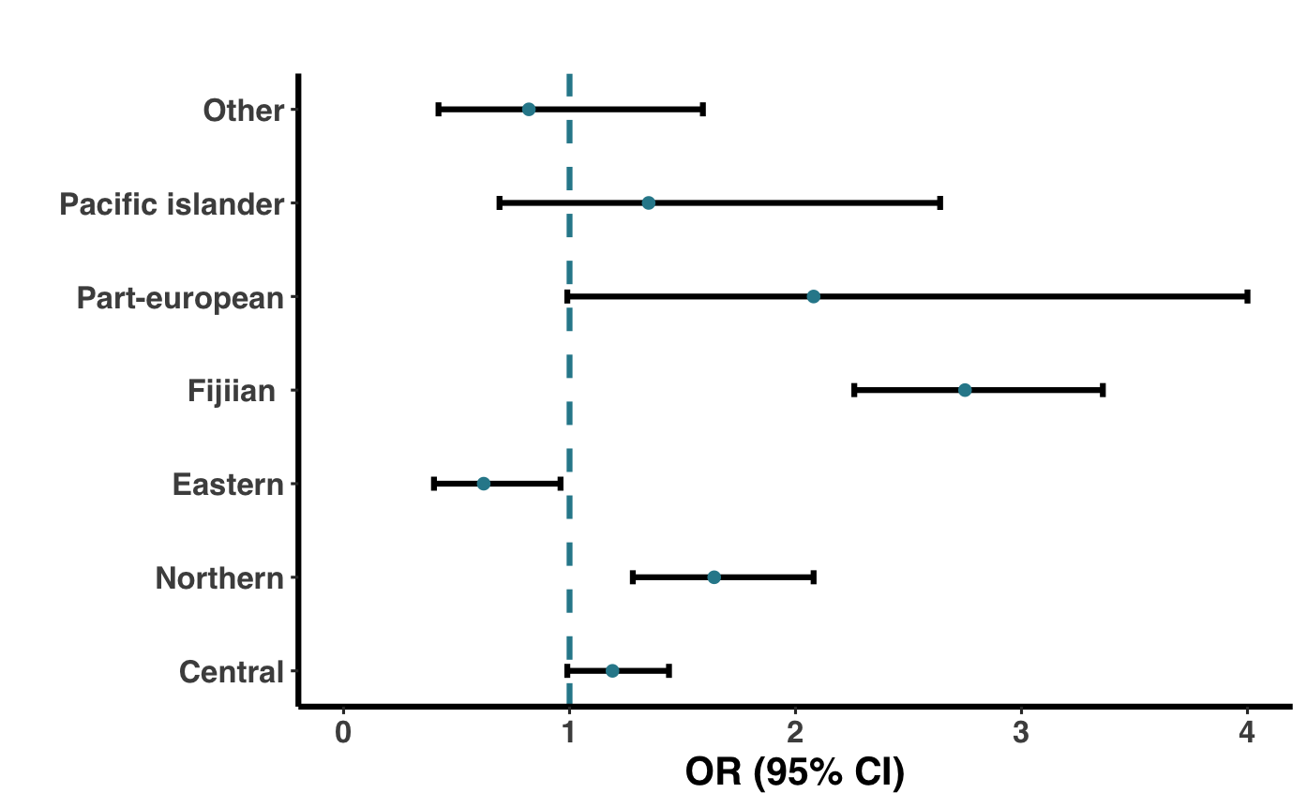
2. Sensitivity analysis
0.82 (0.42-1.59)
1.35 (0.69-2.64)
2.08 (0.99-4.39)
2.75 (2.26-3.36) **
0.62 (0.40-0.96) *
1.64 (1.28-2.08) **
1.19 (0.99-1.44)
* p-value < 0.05, ** p-value < 0.01; reference: Western (region), Indian (ethnicity).

Slide 12

Conclusions
Research question 1:
Significant p value
H0: There is no difference in contraceptive uptake by region
Research question 2:
OR between regions 1
Fijian ethnicity was significant
H0: The odds ratios of not using contraceptives between different regions equal to 1
Notes:
Conclusion for research 2

Slide 13
Implications
Further analysis needed...
Qualitative analysis on why Fijians tend to no use/use inefficient contraceptives
Key recommendation...
Advertising campaigns promoting the availability of free contraceptives should target those living in the Northern region
Other possible factors that can explain the difference between regions

